Slide 1
CAP442 Web Technology
Unit I
Session 9
II Year M.C.A

Slide 2
Contents
Cascading Style Sheets(CSS)
CSS Properties
Background
Radiant
Shadows

Slide 3
Background property
Set different background properties in one declaration:
body {
background: lightblue url("img_tree.gif") no-repeat fixed center;
}
It does not matter if one of the values above are missing,
E.g.
background:#ff0000 url(smiley.gif); is allowed.

Slide 4
The background property is a shorthand property for:
background-color
background-image
background-position
background-size
background-repeat
background-origin
background-clip
background-attachment

Slide 5
Property Description
background-color Specifies the background color to be used
background-image Specifies ONE or MORE background images to be used
background-position Specifies the position of the background images
background-size Specifies the size of the background images
background-repeat Specifies how to repeat the background images
background-origin Specifies the positioning area of the background images
background-clip Specifies the painting area of the background images
background-attachment Specifies whether the background images are fixed or scrolls with the rest of the page

Slide 6
Background color
background-color: color | transparent | initial | inherit;
The background-color property sets the background color of an element.
The background of an element is the total size of the element, including padding and border (but not the margin).

Slide 7
Background Image
The background-image property sets one or more background images for an element.
By default, a background-image is placed at the top-left corner of an element, and repeated both vertically and horizontally.
The background of an element is the total size of the element, including padding and border (but not the margin).

Slide 8
Example: 1 background image
body {
background-image: url("paper.gif");
background-color: #cccccc;
}
Example: 2 background images
body {
background-image: url("img_tree.gif"), url("paper.gif");
background-color: #cccccc;
}

Slide 9
Background-position
The background-position property sets the starting position of a background image.
By default, a background-image is placed at the top-left corner of an element, and repeated both vertically and horizontally.

Slide 10
background-position: value;
Property Value Description
left top, left center, left bottom If only one keyword specified, the other value will be "center"
right top, right center, right bottom
center top, center center, center bottom
x% y% The first value is the horizontal position and the second value is the vertical. The top left corner is 0% 0%. The right bottom corner is 100% 100%. If only one value specified, the other value will be 50%. Default value is: 0% 0%
xpos ypos The first value is the horizontal position and the second value is the vertical. The top left corner is 0 0. Units can be pixels (0px 0px) or any other CSS units. If only one value specified, the other value will be 50%.

Slide 11
Background-repeat
The background-repeat property sets how a background image will be repeated.
By default, a background-image is repeated both vertically and horizontally.
background-repeat: repeat | repeat-x | repeat-y | no-repeat;

Slide 12
Property Values Description
repeat The background image is repeated both vertically and horizontally. The last image will be clipped if it does not fit. This is default
repeat-x The background image is repeated only horizontally
repeat-y The background image is repeated only vertically
no-repeat The background-image is not repeated. The image will only be shown once
space The background-image is repeated as much as possible without clipping. The first and last images are pinned to either side of the element, and whitespace is distributed evenly between the images
round The background-image is repeated and squished or stretched to fill the space (no gaps)

Slide 13
Example:
body {
background-image: url("paper.gif");
background-repeat: repeat;
}

Slide 14
Background-origin
The background-origin property specifies the origin position (the background positioning area) of a background image.
This property has no effect if background-attachment is "fixed".
background-origin: padding-box | border-box | content-box;
Property Values Value Description
padding-box Default value. The background image starts from the upper left corner of the padding edge
border-box The background image starts from the upper left corner of the border
content-box The background image starts from the upper left corner of the content

Slide 15
Example
Set two background images for a <div> element. Let the "paper.gif" background image starts from the upper left corner of the padding edge, and let the "img_tree.gif" background image starts from the upper left corner of the content:
#example1 {
border: 10px dashed black;
padding: 25px;
background: url(img_tree.gif), url(paper.gif);
background-repeat: no-repeat;
background-origin: content-box, padding-box;
}

Slide 16
Background-clip
The background-clip property defines how far the background (color or image) should extend within an element.
background-clip: border-box | padding-box | content-box;
Property Values Value Description
border-box Default value. The background extends behind the border
padding-box The background extends to the inside edge of the border
content-box The background extends to the edge of the content box

Slide 17
Specify how far the background should extend within an element:
div {
border: 10px dotted black;
padding: 15px;
background: lightblue;
background-clip: padding-box;
}

Slide 18
Background-attachment
The background-attachment property sets whether a background image scrolls with the rest of the page, or is fixed.
background-attachment: scroll | fixed | local;
Property Values Value Description
scroll The background image will scroll with the page. This is default
fixed The background image will not scroll with the page
local The background image will scroll with the element's contents

Slide 19
A background-image that will scroll with the page (scroll). This is default:
body {
background-image: url("img_tree.gif");
background-repeat: no-repeat;
background-attachment: scroll;
}

Slide 20
Gradients
CSS gradients let you display smooth transitions between two or more specified colors.
CSS defines two types of gradients:
Linear Gradients (goes down/up/left/right/diagonally)
Radial Gradients (defined by their center)

Slide 21
Linear Gradients
To create a linear gradient define at least two color stops.
Color stops are the colors you want to render smooth transitions among.
We can also set a starting point and a direction (or an angle) along with the gradient effect.

Slide 22

background-image: linear-gradient(direction, color-stop1, color-stop2, ...);
#grad {
background-image: linear-gradient(to right, red , yellow);
}

Slide 23
Using Angles
We can define an angle, instead of the predefined directions (to bottom, to top, to right, to left, to bottom right, etc.).
A value of 0deg is equivalent to "to top". A value of 90deg is equivalent to "to right". A value of 180deg is equivalent to "to bottom".

Slide 24
background-image: linear-gradient(angle, color-stop1, color-stop2);
#grad {
background-image: linear-gradient(180deg, red, yellow);
}
The following example shows how to create a linear gradient (from left to right) with the color of the rainbow and some text:
#grad {
background-image: linear-gradient(to right, red, orange, yellow, green, blue, indigo, violet);
}

Slide 25
Using Transparency
Transparency can be used to create fading effects.
To add transparency, use the rgba() function to define the color stops. The last parameter in the rgba() function can be a value from 0 to 1, and it defines the transparency of the color: 0 indicates full transparency, 1 indicates full color (no transparency).

Slide 26

#grad {
background-image: linear-gradient(to right, rgba(255,0,0,0), rgba(255,0,0,1));
}

Slide 27
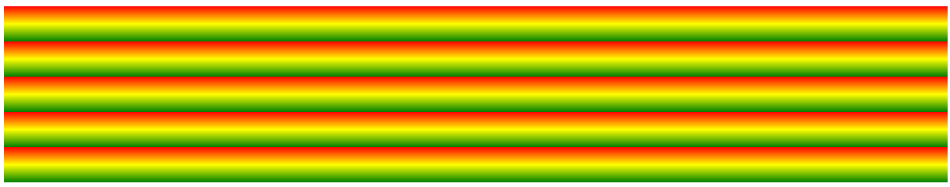
Repeating a linear-gradient
The repeating-linear-gradient() function is used to repeat linear gradients:
#grad {
background-image: repeating-linear-gradient(red, yellow 10%, green 20%);
}

Slide 28
Radial Gradients
A radial gradient is defined by its center.
To create a radial gradient define at least two color stops.
background-image: radial-gradient(shape size at position, start-color, ..., last-color);
By default, shape is ellipse, size is farthest-corner, and position is center.

Slide 29

#grad {
background-image: radial-gradient(red, yellow, green);
}

Slide 30

#grad { background-image: radial-gradient(circle, red, yellow, green); }

Slide 31
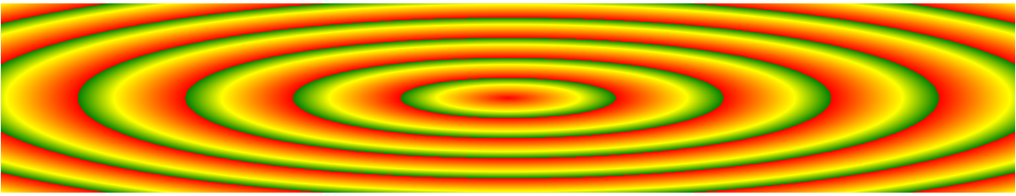
A repeating radial gradient:
#grad {
background-image: repeating-radial-gradient(red, yellow 10%, green 15%);
}

Slide 32
Shadows
We can add shadow to text and to elements.
Shadow can be applied to text and box
text-shadow property
box-shadow property

Slide 33

Text Shadow
The CSS text-shadow property applies shadow to text.
Values for this property are, horizontal shadow, vertical shadow, blur, color.
h1 {
text-shadow: 2px 2px 5px red;
}

Slide 34

Multiple Shadows
To add more than one shadow to the text, we can add a comma-separated list of shadows.
The following example shows a white text with black, blue, and darkblue shadow:
h1 {
color: white;
text-shadow: 1px 1px 2px black, 0 0 25px blue, 0 0 5px darkblue;
}

Slide 35
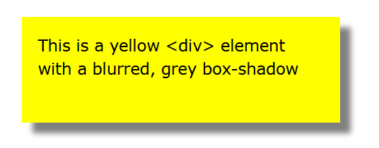
Box-shadow
The CSS box-shadow property applies shadow to elements.
In its simplest use, you only specify the horizontal shadow and the vertical shadow:
div {
box-shadow: 10px 10px 5px grey;
}

Slide 36
Cards
Box-shadow property can be used to create paper-like cards:
div.card {
width: 250px;
box-shadow: 0 4px 8px 0 rgba(0, 0, 0, 0.2), 0 6px 20px 0 rgba(0, 0, 0, 0.19);
text-align: center;
}

Slide 37
<!DOCTYPE html>
<html>
<head>
<style>
div.card {
width: 250px;
box-shadow: 0 4px 8px 0 rgba(0, 0, 0, 0.2), 0 6px 20px 0 rgba(0, 0, 0, 0.19);
text-align: center;
}
div.header {
background-color: #4CAF50;
color: white;
padding: 10px;
font-size: 40px;
}
div.container {
padding: 10px;
}
</style>
</head>

Slide 38
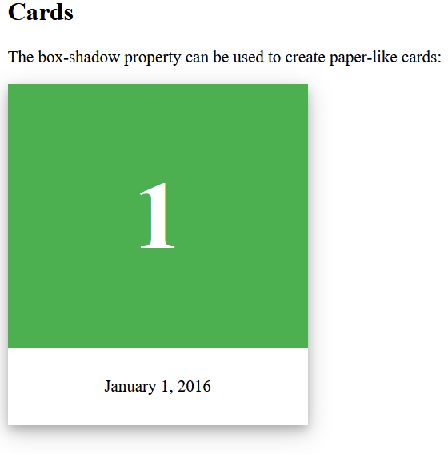
<body>
<h2>Cards</h2>
<p>The box-shadow property can be used to create paper-like cards:</p>
<div class="card">
<div class="header">
<h1>1</h1>
</div>
<div class="container">
<p>January 1, 2016</p>
</div>
</div>
</body>
</html>

